Slide 1
4 – Clean Code – Function Structure
Based on the CleanCoders videos by Uncle Bob Martin
Rupert Waldron

Slide 2
How many arguments should a function have?
The best functions should have zero arguments, three is normally too many – difficult to remember the order.
The same reasoning applies to constructors – can use setters and builders instead.
Try to avoid passing Booleans to functions create separate functions, when you pass a Boolean you are saying that your function has two paths or does two things, one for the True case and another for the False case
No output arguments if possible in functions use ONLY the return value to pass data out of a function. This will cause your reader to do a double take.
Avoid functions that can take None or null or expects one of these invalid values because we are saying the function handles two possible states, one for the null case and one for the non-null case, write to functions one that takes no arguments (for null case) and one that takes one single argument (for non-null case)
Try to avoid defensive programming, checking for null/None checks and error code checks, try to write code that prevents you from passing null/None values – Protect your code with a good suit of tests.
Public apis do need good checking.

Slide 3
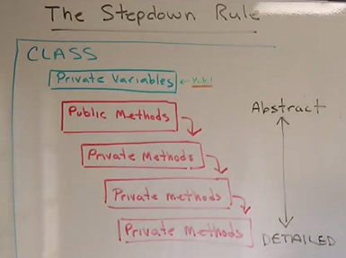
Step down method

Slide 4
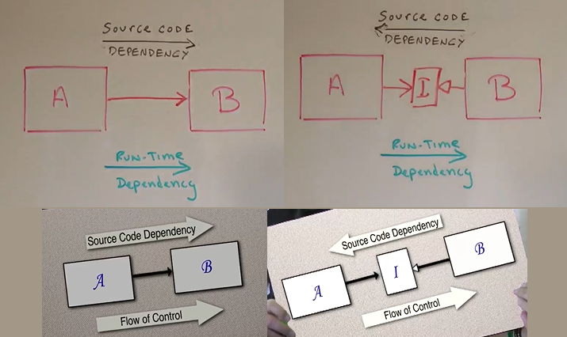
Dependency Inversion – Allows Independent Deployability
Module A calls module B. If Module B changes this will force a recompile of module A. So they are coupled and can’t be deployed separately.
We can invert the dependency by adding an Interface which Module A depends upon. The source code dependency is now inverted.

Slide 5
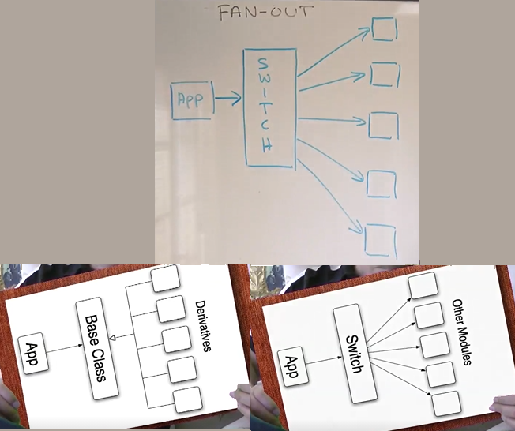
Switch Statements – Fan out
Fan-out: the switch statement in dependent on all the downstream modules. If there is a change in one of those modules the App will need to be recompiled and redeployed.
Switch statements create a web of dependencies. What options do we have?
1) Create a base class with derivatives to invert the flow – replace the argument of the switch with a abstract base class – then call a method on the derivatives – see example.
2) Switches are ok in factories…
Long chains of if-else have the same problem of switch statements

Slide 6
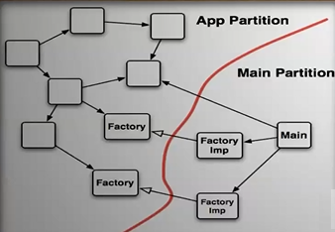
public static void main(String[] args)
The main partition should have concrete classes with dependencies all pointing towards the application, there should be no dependencies pointing the other way – main is a plugin to the application.
Switch statements can reside quite happily in the main partition because the dependencies will go in one direction – main() is an independently deployable plugin and can be deployed separately.
The goal of partitioning is independent deployability… Also independent developability
The structure of the program should be core and plugins – all the arrows should point inwards towards the core. The core should no nothing about the plugins.

Slide 7
Side Effects – set / get … new / delete – source of problems
Functional Programming
Don’t use assignment operators.
No side affects.
Same input, same output.
public void takePaymentFromClient(float payment) { hasClient = true; if (isHappyWithPayment(payment)) { hasCrossedPalmWithSilver = true; } }
Side effect functions come in pairs (get / set) – and normally need to be invoked in the correct order – Temporal Coupling
public static void main(String[] args) { FortuneTeller fortuneTeller = new FortuneTeller(); Random r = new Random(); IntStream.rangeClosed(1, 10) .forEach(i -> { float payment = r.nextFloat() * 20F; System.out.println(payment); fortuneTeller.takePaymentFromClient(payment); System.out.println(fortuneTeller.tellFortune()); }); }
public static void main(String[] args) { FortuneTellerDeCoupled fortuneTeller = new FortuneTellerDeCoupled(); Random r = new Random(); IntStream.rangeClosed(1, 10) .forEach(i -> { float payment = r.nextFloat() * 20F; System.out.println(payment); System.out.println(fortuneTeller.welcomeClient(payment)); }); }
Remove Temporal Coupling

Slide 8
Side Effects – CQRS
Reduce Side Effects using CQRS – Command Query Separation
Functions that change state shouldn’t return values – should expect side effects.
Functions that return values shouldn’t change state – should NOT expect side effects.
public class Authorise { private List<String> authorisedUsers = List.of("Rupert"); private String authoriseUser; public void authoriseUserGood(String user) throws IllegalAccessException { if (authoriseUser.contains(user)) authoriseUser = user; else throw new IllegalAccessException("User isn't authorised"); } public boolean authoriseUserBad(String user) { if (authoriseUser.contains(user)) { authoriseUser = user; return true; } return false; } }

Slide 9
Tell Don’t Ask
public class TrainWreck { public static void main(String[] args) { X x = new X(); x.getY().getZ().doSomething(); // don't do this x.doSomething(); // do this instead } } class X { private Y y = new Y(); public Y getY() { return y; } public void doSomething() { y.doSomething(); } } class Y { private Z z = new Z(); public Z getZ() { return z; } public void doSomething() { z.doSomething(); } } class Z { public void doSomething() { System.out.println("Something"); } }
Don’t ask an object for information and make decisions for the object – breaks encapsulation
Tell an object to do something using - it then uses its internal state. This will reduce the number of query functions.
We don’t want our functions to have access to too much knowledge by winding their way through the system.
We just want to tell the neighbouring object what we want done.
Law of Demeter
You may call methods of objects that are:
Passed as arguments
Created locally
Instance Variables
Globals
You may NOT call methods on objects that are:
Returned from a previous method call.

Slide 10
Mid-Function Returns
This is ok
private int calculateAge10YearsAgo(int currentAge) { if (currentAge < 10) return 0; // early returns are fine when they are easy to read return currentAge - 10; }
Avoid breaks in loops especially, Labelled breaks.
private int getMonthNumber(String month) { int result = 0; for (int i = 0; i < Months.getMonthNames().length; i++) { if (month.equals(Months.getMonthNamesShortened()[i])) { result = i; break; } if (month.equals(Months.getMonthNames()[i])) { result = i; break; } } return result; }
If you keep your functions as small as they should be it is much easier to avoid these pitfalls.

Slide 11
Error Handling
The checked exception experiment in Java has failed. It failed in C++, C# didn’t even bother.
So what’s the problem:
Checked exceptions cause a reverse dependency up the hierarchy.
If a sub-module throws a checked exception this will have to be dealt with up the hierarchy.
The higher up modules will need to be recompiled and redeployed - Violate independent deployability.
It violates the Open Close Principle.
Plus it is a pain in the butt.
Error handling is important, but if it obscures logic, it is wrong – Michael Feathers
Do Not use Checked Exceptions – Derive all your exceptions from RuntimeException.
Do Not messages is exceptions, let the name, context and scope do the work for you.
private int getMonthNumber(String month) { int result = 0; for (int i = 0; i < Months.getMonthNames().length; i++) { if (month.equals(Months.getMonthNamesShortened()[i])) { result = i + 1; break; } if (month.equals(Months.getMonthNames()[i])) { result = i + 1; break; } } if (result == 0) throw new InvalidMonthNameException(); return result; } public class InvalidMonthNameException extends RuntimeException {}

Slide 12
Try-catch blocks
Try catch block guidelines:
If the word ”try” appears in a function it must be the first word in that function after any variable declarations.
The body of the try block must contain a single function call.
The catch and finally blocks are the very last things in the function. Nothing follows them.
private Integer safeMonthNumberFetcher(String month) { try { return getMonthNumber(month); } catch (InvalidMonthNameException ivmne){ System.out.println("Invalid month name"); return null; } }
Remember functions are supposed to do one thing. Handling errors is one thing.

